Slide 1
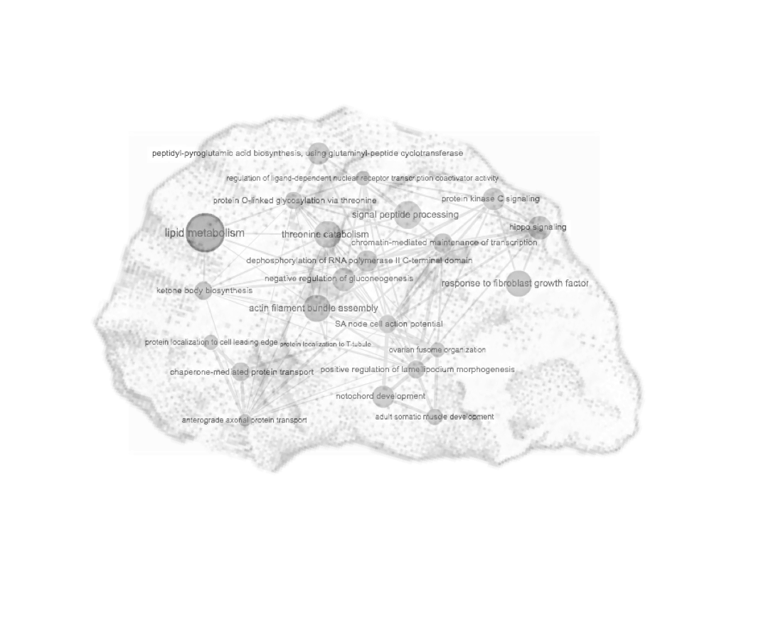



A protein inventory reveals mechanisms of temperature impact on oyster development
Shelly Trigg, Ph.D.
strigg@uw.edu
Steven Roberts Lab, School of Aquatic and Fishery Sciences
University of Washington, Seattle, WA
Notes:
Hi everyone, I’m Shelly Trigg and I’m a postdoctoral researcher in Steven Robert’s lab at the University of Washington in the School of Aquatic and Fishery sciences. Today I’m going to talk about a study on how temperature impacts oyster development through its influence on hundreds proteins

Slide 2



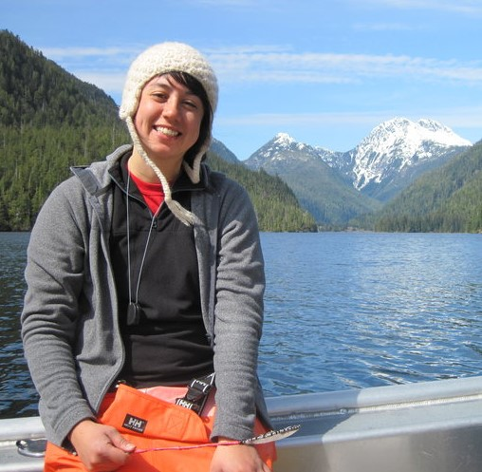
Acknowledgements
Benoit Eudeline
Award NA140AR4170078
Project R/SFA-8
Kaitlyn Mitchell
Rhonda Elliot
Steven Roberts
Emma Timmins-Schiffman
Brent Valdopalas
Grace Crandall
Yaamini Venkataramen
Laura Spencer
Sam White
Notes:
I’d first like to acknowledge the people who carried out the experiment part of the project. This was a WA Sea Grant funded project and was a collaboration between UW and Taylor Shellfish. Rhonda Elliot was a graduate student who did the experiment with Benoit at Taylor. Kaitlyn Mitchell was an undergrad and lab technician who did preliminary data analysis. I’d also like to acknowledge other Roberts lab members for their support.

Slide 3
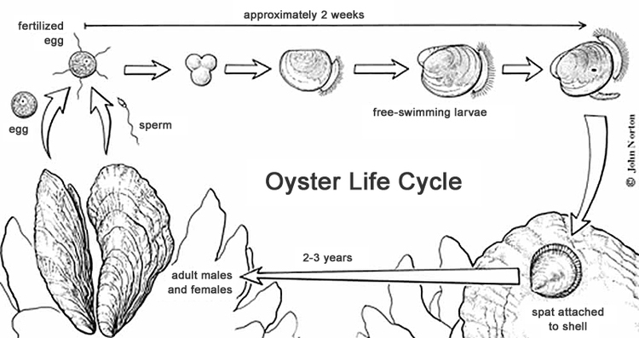
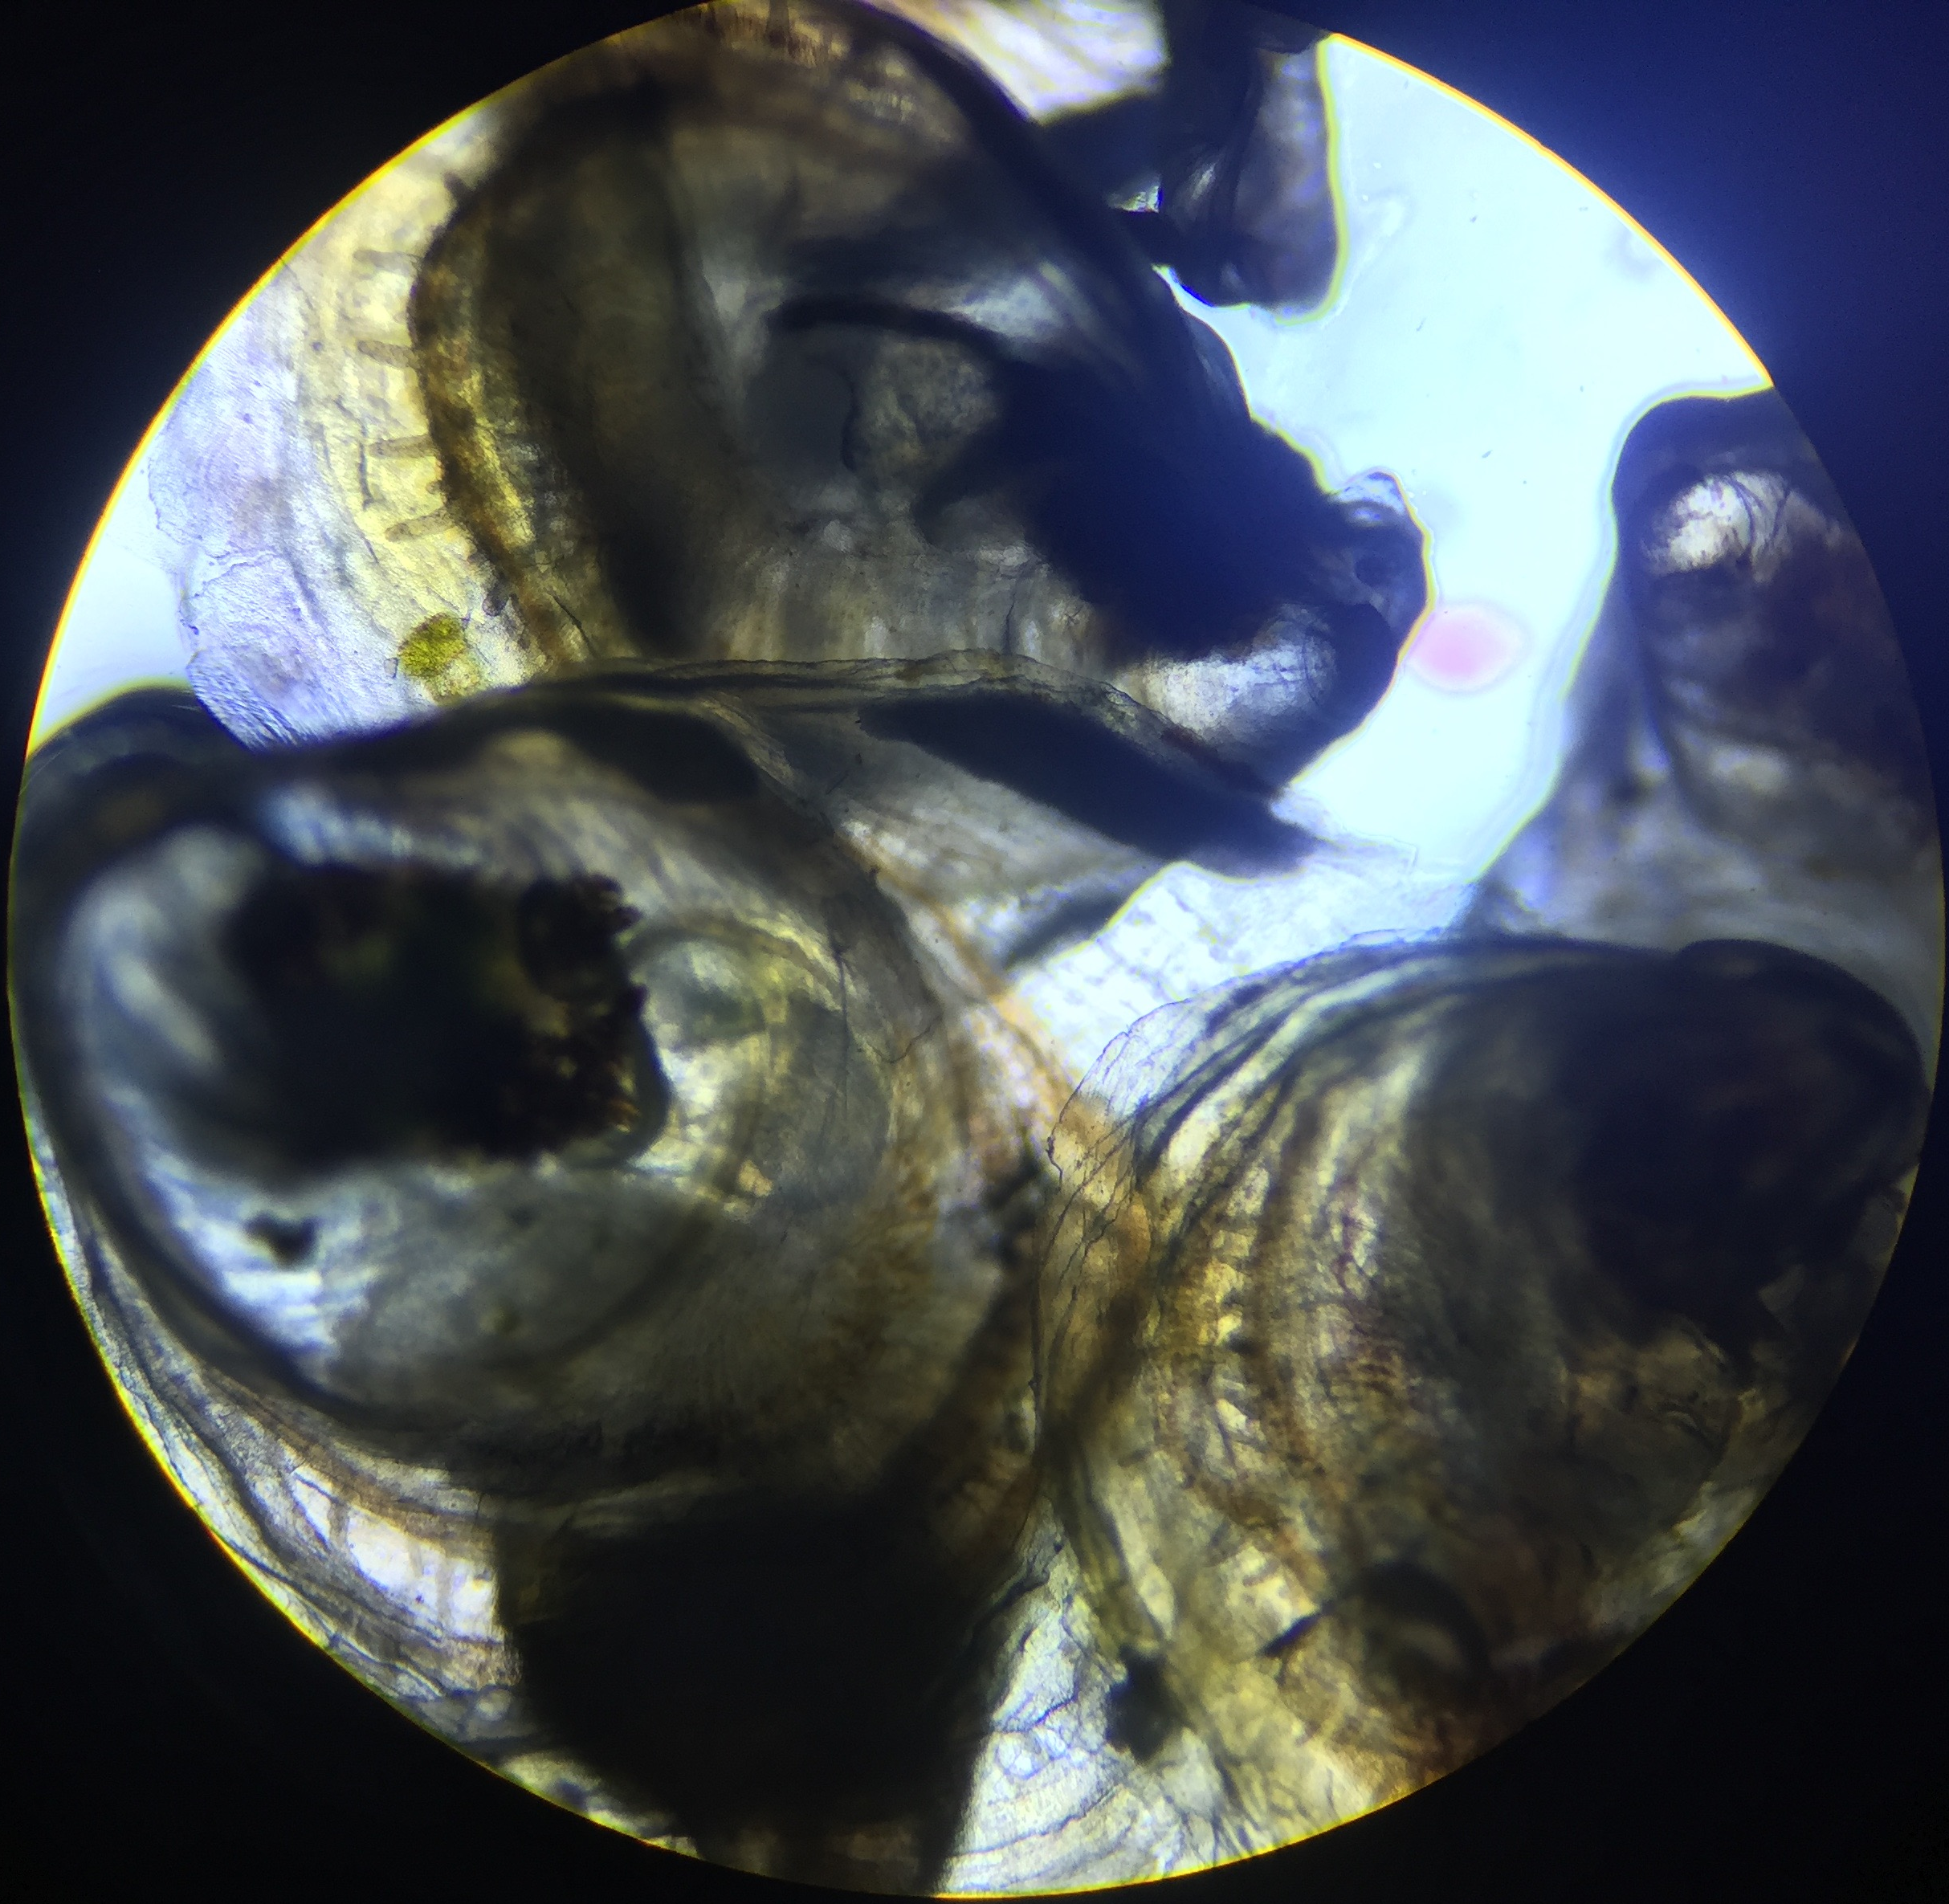
Oyster (C.gigas) seed are delicate
Pacific oyster are sensitive to environmental conditions from larval transition → early stage juveniles
High mortality typically happens 10-14 days post-set @23C
Increased rearing temperature (27-29°C) has lead to increased growth rates and survival
We don’t fully understand oyster physiology, why high mortality occurs, or why increased rearing temperature helps
A thorough molecular baseline of oyster development during this life stage could help:
identify candidate biomarkers for monitoring seed health
mitigate current challenges
Oyster seed
Oyster seed
Notes:
Pacific oyster are sensitive to environmental conditions especially during larval transition to early stage juveniles and during early juvenile development. The standard rearing temperature of juveniles is currently 23C, but as you know growers commonly experience mass mortality events with oyster seed typically 10-14 days post-set. Studies have shown increased rearing temperatures can lead to increased growth rate and survival. BUT we don’t fully understand oyster physiology, why high mortality occurs, or why increased rearing temperature helps.

Slide 4
Questions
What fundamental physiology occurs during oyster development?
How do warmer temperatures affect juvenile development on a global molecular level?
Notes:
In this study I set out to answer the following questions:
IF we knew the fundamentals, we’d better know what to test for to make sure they are healthy

Slide 5

Experimental Design
temperature treatment:
23°C
29°C
13 days
19
21
23
25
27
29
31
33
35
Days post fertilization (dpf)
Notes:
The experimental setup was as follows: free swimming larvae with pedal appendages were exposed to either the standard 23C or... They were held under these conditions for 13 days
1M seed /treatment

Slide 6
Size and survival differences between temperature groups
Difference in survival at 35 dpf
Difference in size distribution but not survival at 24 dpf
Size at day 24 dpf ( day 6 of temperature treatment)
3x
2x
29°C has more animals of larger size
Notes:
At 24 dpf, when the majority of settlement occurred,

Slide 7
Experimental Design
temperature treatment:
23°C
29°C
19
21
23
25
27
29
31
33
35
Days post fertilization (dpf)
proteomics
Notes:
50 seed/pool/timepoint

Slide 8
Proteomics = global protein inventory
Proteins are the active players in the cell that carry out biological processes
Non-biased birds eye view of all proteins present and their abundances
We can infer what processes are going on
We can make comparisons between individuals and see what processes may underlie different outcomes
Proteomics workflow

Slide 9
Proteomics comparisons
1. Fundamental development:
Proteins abundances that commonly change over time
23°C
29°C
2. Temperature effect:
Proteins abundance differences driven by temperature
23°C
29°C
3. Silo effect:
Protein abundance differences driven by silo
23°C
23°C
Notes:
Next I’m going to walk you through some different comparisons. 1 is …

Slide 10
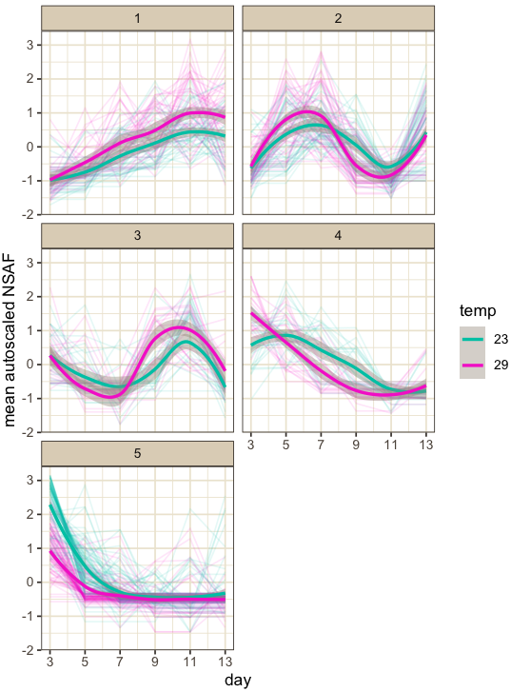
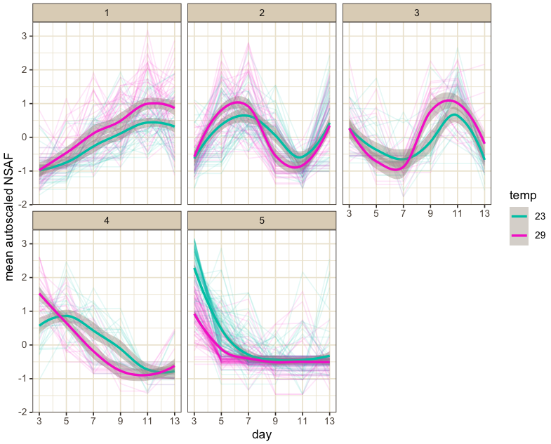
Clustering differentially abundant proteins reveals 5 distinct patterns over time
19
21
23
25
27
29
31
dpf
°C
21 23 25 27 29 31
21 23 25 27 29 31
Notes:
These are some complicated plots, but I’m going to walk you through them. This is a heatmap… You can see that proteins can be clustered into 5 groups or clades. For instance, proteins in this teal group tend to show high abundance early on with a sharp decrease after 2 days flatlining through the rest of development. Where proteins in the purple group show high abundance early on but a more gradual decrease over time. So now that we can better understand protein abundances over time, we can infer what processes related to these proteins may be occurring earlier on versus later in development.

Slide 11
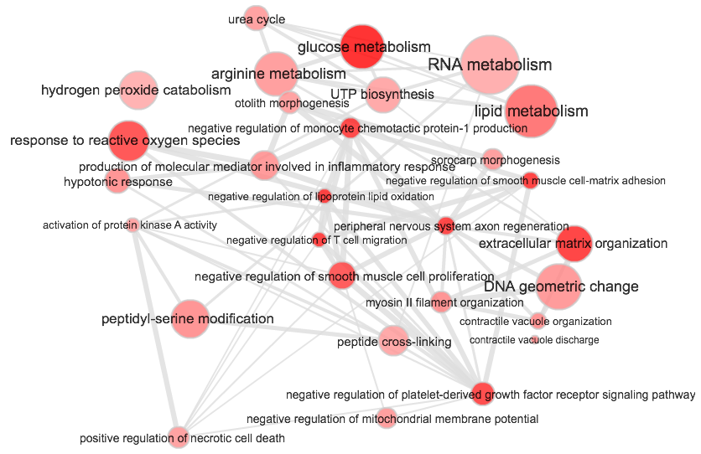
Early developmental processes that sharply decrease over two days
Clade 5
Glucose metabolism
Response to reactive O₂ species
Extracellular matrix organization
Mean abundance factor (NSAF)
21 23 25 27 29 31
dpf

Slide 12
Protein patterns and processes we could expect to see in normal development
Glycolytic process and glucose homeostasis
Cortical cytoskeleton organization
Regulation of cilium assembly
Extracellular matrix organization
Mean abundance factor (NSAF)
Actin cytoskeleton organization
Synaptic vesicle exocytosis
Stress signaling
Apoptotic process
Amino and nucleic acid metabolism
21 23 25 27 29 31
Glucose metabolism
Response to reactive O₂ species
Extracellular matrix organization
21 23 25 27 29 31
dpf

Slide 13
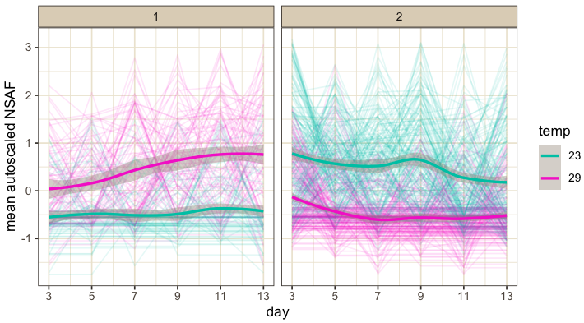
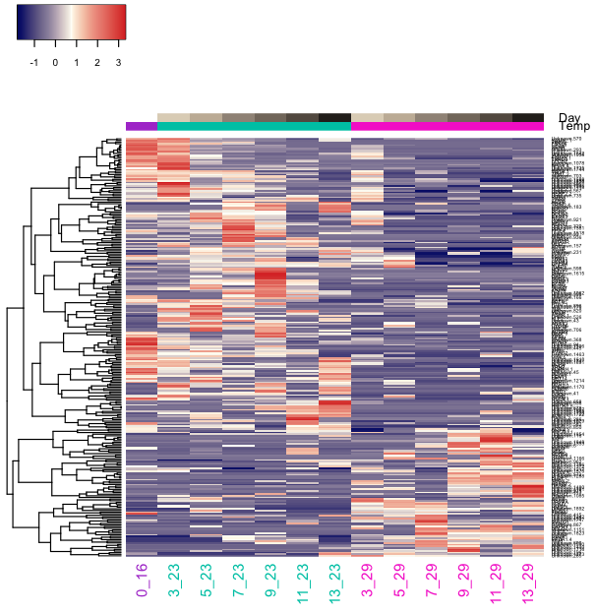
Proteins and processes underlying increased growth and survival at 29°C
21 23 25 27 29 31
dpf
21 23 25 27 29 31
Lipid metabolism
Response to fibroblast growth factor
Actin filament bundle
Microtubule-based process
Positive regulation of cell death
Protein homotetramerization
Clade 2
Clade 1

Slide 14
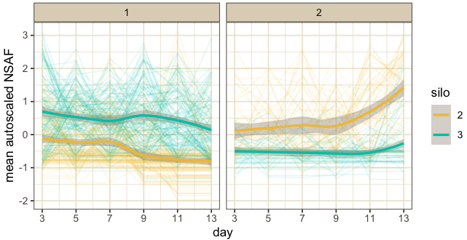
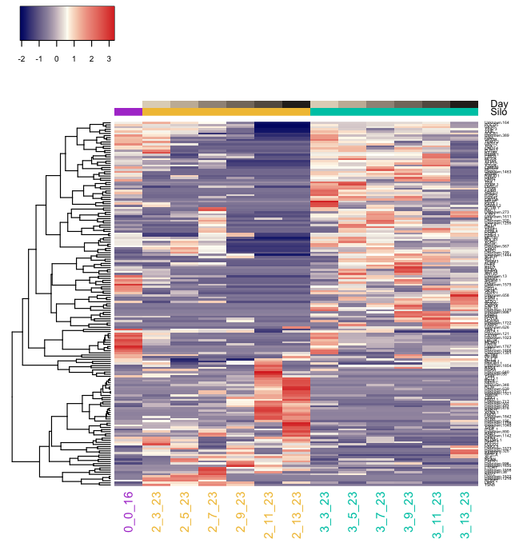
Proteins and processes underlying decreased survival at 23°C
21 23 25 27 29 31
dpf
21 23 25 27 29 31
Pyrimidine nucleoside salvage
Cellular amino acid metabolism
Endosome transport via multivesicular body sorting pathway
Regulation of exocytosis
Regulation of cholesterol import and esterification
Rab protein signal transduction
Clade 1
Clade 2

Slide 15
Significance and the future
Conclusions
29°C rearing led to increased size and survival
Proteomics data show clear physiological differences between animals reared at 29°C and 23°C
Established a baseline protein and biological process inventory for fundamental oyster development
Identified set of proteins and potential processes underlying decreased survival
Identified set of proteins and potential processes underlying increased growth and survival
Proteins in these sets have potential to be biomarkers for determining the health status of seed and predicting outcome before mass mortality events happen
Need to measure top ranked proteins and/or cell processes on a larger scale
Shelly Trigg (strigg@uw.edu)

Slide 16
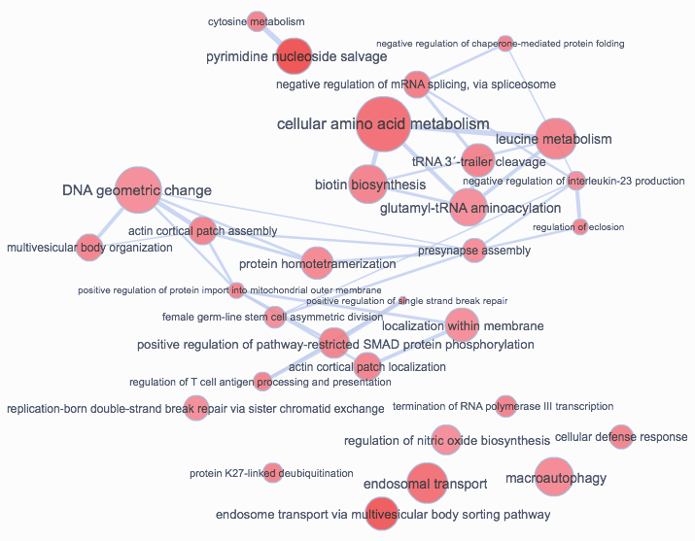
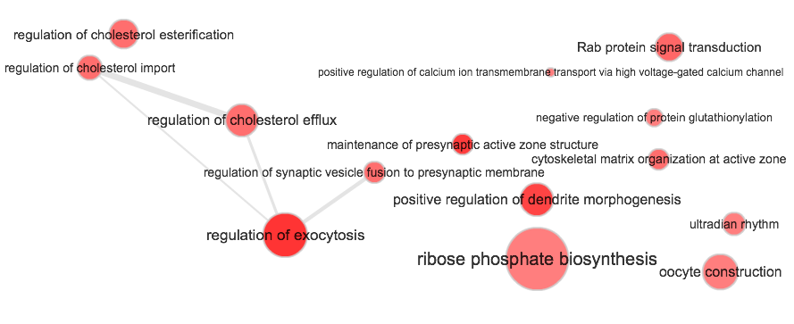
Results: biological processes significantly affected by silo at 23C
Down-regulated process (clade 1):
Up-regulated process (clade 2):

Slide 17
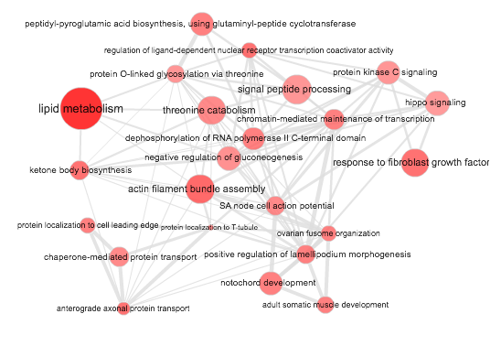
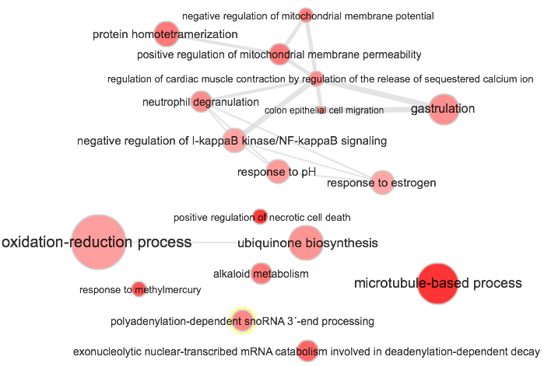
Results: biological processes enriched at 29C
clade 1
clade 2
Up-regulated processes:
Down-regulated processes:

Slide 18
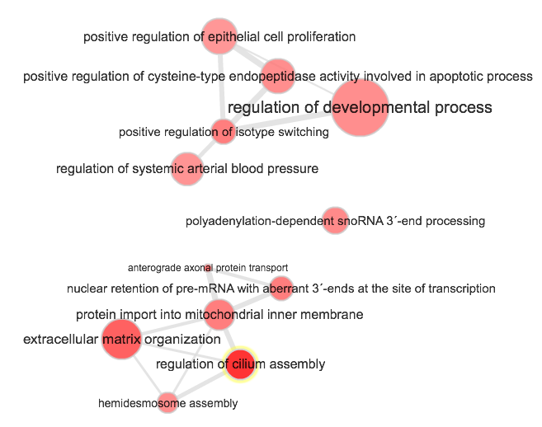
Early developmental processes that gradually decrease over two days
Clade 4
Regulation of cilium assembly
Extracellular matrix organization
Mean abundance factor (NSAF)
dpf

Slide 19
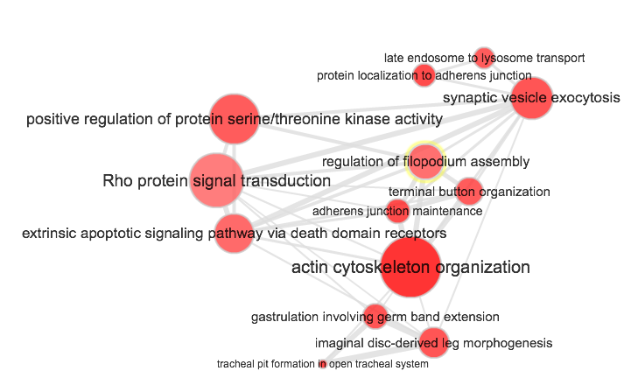
Results: biological processes significantly affected by time
Clade 3

Slide 20
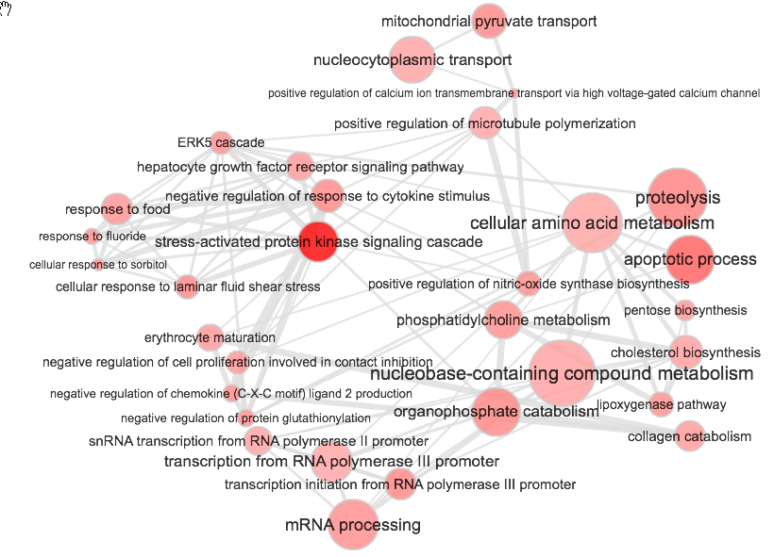
Results: biological processes significantly affected by time
Clade 2
Stress signaling
Apoptotic process
Amino and nucleic acid metabolism

Slide 21
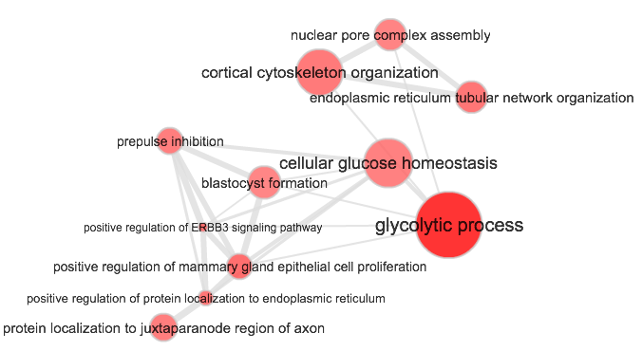
Results: biological processes significantly affected by time
Clade 1

Slide 22
5
4
2
1
3

